Slide 2
Proof of Concept and Prototype Micro-Frontend
Architecture

Slide 3
Plan
[OK] Get context of PoC.
[OK] Build a team.
[OK] Get requirements.
[Run] Set up on WOM.
[Run] Implementation.

Slide 4
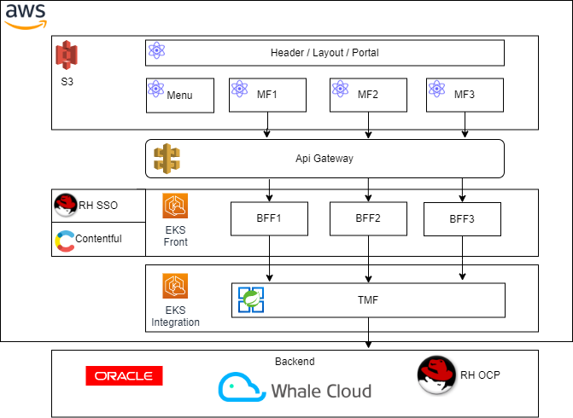
Context (Labs)

Slide 5
Plan
[OK] Get context of PoC.
[OK] Build a team.
Front Developers : Nestor B., Andres M+1.
Leader Cell’s : Mario G., Rodrigo P.
Architects : Hans S., Cesar O.
[OK] Get requirements.
[Run] Set up on WOM.
[Run] Implementation.

Slide 6
Requirements of POC
Component reuse
Use by iframe, web y application container.
Security Authorization/ Authenticate (Public, Customer and Collaborator).
Development velocity.
Selected Functionality
Check Availability for Fiber Public (Factibilidad Fibra)

Slide 7
Plan
[OK] Get context of PoC.
[OK] Build a team.
Front Developers : Nestor B., Andres.
Leader Cell’s : Mario G., Rodrigo P.
Architects : Hans S., Cesar O.
[OK] Get requirements.
[Run] Set up on WOM.
[Run] Implementation.

Slide 8
Set up WOM
[OK] Select microfront framework
“Single-SPA”
[OK] Get git sources old PoC.
[OK] Local execution of old PoC.
[Run] Define the epic and histories.

Slide 9
Plan
[OK] Get context of PoC.
[OK] Build a team.
Front Developers : Nestor B., Andres.
Leader Cell’s : Mario G., Rodrigo P.
Architects : Hans S., Cesar O.
[OK] Get requirements.
[Run] Set up on WOM.
[Run] Implementation.

Slide 10
Implementation (Jira EA-37)
Functional Histories
[dev] Check Availability for Fiber Public.
[dev] FrontLabs for Microfrontends (menu, header, bar and static).
Technical Histories
[dev] Callable from iframe, embed and front labs.
[Sec] Cookies many context security
[Arq] Get anonymous token
[DevOps] CI/CD by Microfrontend.
[QA] Quality gates (Automatically test, best practices, libraries Wom supported).
[Arq] External Conversational input/ouput
[Arq] Framework Selection for microfronends

Slide 11
Front Technology Stack
React
Single SPA (Microfrontend Framework).
AWS
Buckets
Cloud Front
API Gateway

